Slide 1
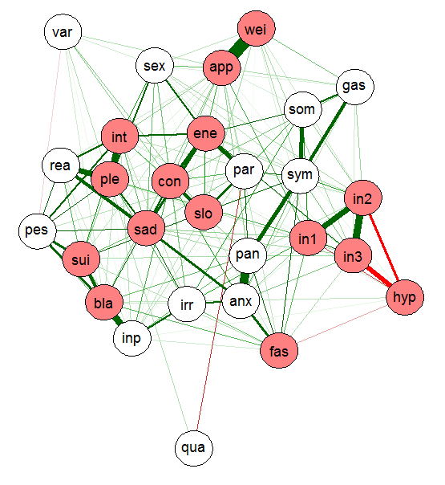
Depression is more than the sum-score of its symptoms:
A novel network approach to understanding depression
Eiko Fried
KU Leuven

Slide 2
Major Depression (MD)
Prevalence
  Most common psychiatric disorder
Recurrence
  50-75% suffer from more than on episode
  Previous episodes reduce treatment efficacy
Disability
  Greatest impact of all biomedical diseases on disability
  Closely related to suicide and a variety of life-threatening conditions (coronary heart disease, diabetes)
  60% report severe or very severe impairment of functioning
Costs
  US: > $30 billion per year

Slide 3

Let's conduct a typical depression study

Slide 4
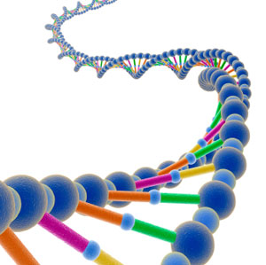
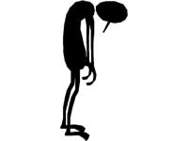

Hypothesis
People with Major Depression (MD) have different genes compared to healthy controls

Slide 5
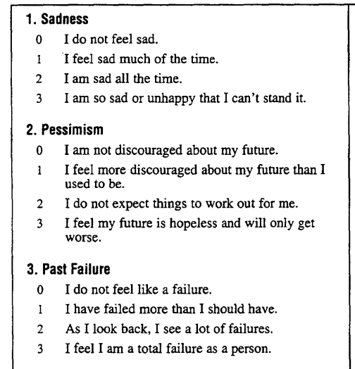
Procedure
Depression
  Select questionnaire to assess depression symptoms
  21-item BDI

Slide 6
Procedure
Depression
  Select questionnaire to assess depression symptoms
  21-item BDI
  Build sum-score of symptoms
  Distinguish between healthy controls and MD participants based on threshold
Genetics
  Examine participants' genomes

Slide 7
Sample
500 depressed individuals, 500 healthy controls
  MD group: mean of 14 points
  Healthy group: mean of 7 points

Slide 8

Results
No differences at all between genomes of depressed group and control group

Slide 9


Results
No differences at all between genomes of depressed group and control group

Slide 10
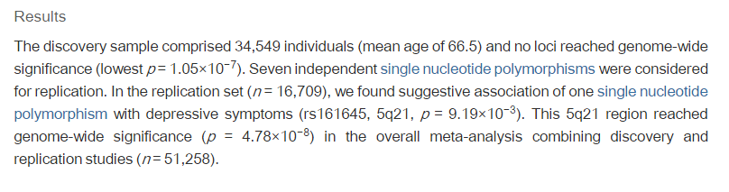
Previous studies
Hek et al., 2013
See
See also:
  Lewis et al., 2010; Shi et al., 2011; Wray et al., 2012; ...

Slide 11
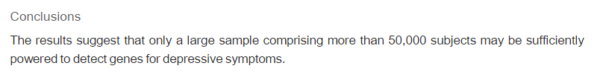
Discussion
Hek et al., 2013
Jeffrey Lieberman, president of the American Psychiatric Association : progress "has been largely limited by technology"

Slide 12
Proceed to publish this typical depression study
"Null findings due to technology and sample size"
Notes:
Accepted in psych medicine just a few weeks ago

Slide 13
Other problems in depression research
Antidepressants are only marginally efficacious compared to placebos, and only work "at the upper end of the very severely depressed category […] even there, differences are small."
(Kirsch et al., 2008; Pigott et al., 2010; Turner et al., 2008)
Diagnostic and Statistical Manual (DSM-5) field trials: "questionable" inter-rater reliability of ~0.3
(Regier et al., 2013)

Slide 14
Other problems in depression research
Antidepressants are only marginally efficacious compared to placebos, and only work "at the upper end of the very severely depressed category […] even there, differences are small."
(Kirsch et al., 2008; Pigott et al., 2010; Turner et al., 2008)
Diagnostic and Statistical Manual (DSM-5) field trials: "questionable" inter-rater reliability of ~0.3
(Regier et al., 2013)
Dramatic lack of progress in key research areas. Hypothesis: sample size and technology are probably not the main reasons. Instead, the main problem is our understanding of what depression is.

Slide 15
LIPS lecture today
Main goal: explain dramatic lack of progress in MD research
Problematic assumptions of depression research
  Depression as a natural kind
  Depression as the common cause of its symptoms
Network approach to MD

Slide 16
Assumption 1:
MD is a natural kind
Notes:
Accepted in psych medicine just a few weeks ago

Slide 17
Infectious diseases
Robert Koch, 1905: discovery that specific diseases have specific causative agents (tuberculosis & syphilis)
Diseases understood as natural kinds:
  Natural kinds are unchanging and ahistoric entities with sharp boundaries that have a specific set of properties (e.g., symptoms) both necessary and sufficient for classification
This type of classification is called essentialism
An essence is "some kind of underlying, intrinsic property, something that lies within kind members, making them the kind of thing that they are" (Wilson et al., 2007; p. 3)
Notes:
At the turn of the 19th century, Koch discovered …

Slide 18
Infectious diseases
Measles: infection of the respiratory system caused by a specific virus, accompanied by specific symptoms like red eyes, fever, generalized rash, and Koplik's spots. Natural kind perspective: measles exists outside the human classification system as real thing.
Gold: atomic number 79, and everything with this atomic number is gold. Specific properties ("essence"), and sharp boundary to all things that are not gold.
Notes:
At the turn of the 19th century, Koch discovered …

Slide 19
General paresis
1910: discovery of syphilitic bacteria in brains of deceased patients diagnosed with "general paralysis of the insane"
  Neuropsychiatric syndrome of late-stage syphilis
  Clear "essence" identified for a mental disorder
  Disease model applied to the rest of medicine, including psychiatry
1912, Alfred Roche:
  "The main example of a happy final definition of a disease condition […] has been general paresis. The success achieved here has perhaps been a misfortune in its side effects because it nourished the illusion that something similar might soon be repeated."
Notes:
At the turn of the 19th century, Koch discovered …

Slide 20
General paresis
1959, Kurt Schneider:
  "General paresis […] became the model for forming disease entities. It was thought it would continue thus, it was hoped that with time more and more such disease entities would emerge from the multifarious conditions of the mentally ill. In fact, however, this did not happen."
Disease model still considered valid today, but no further "essences" detect for mental disorders
Notes:
At the turn of the 19th century, Koch discovered …

Slide 21
Mental disorders as natural kinds
The hypothesis of mental disorders as natural kinds has been present throughout the history of psychiatry
Gerald Klerman, chief of the US national mental health agency, 1978:
  "there is a boundary between the normal and the sick"
  "there are discrete mental disorders"
Aim of developing specific treatments for particular disorders, and of finding specific underlying biological abnormalities
  Think back to our study!
Notion of categorical nature of mental disorders also reflected in more recent developments like the DSM-5
Notes:
At the turn of the 19th century, Koch discovered …

Slide 22
Mental disorders as natural kinds
This is more than just a belief or a tacit assumption—it is reflected in everyday research practices
Disparate depression symptoms added to sum-scores, thresholds distinguish between depressed group and control group
The search for potential causes then proceeds as if depression is a natural kind, similar to measles
Definition of MD as disease entity has discouraged attention to specific depression symptoms and their dynamic interactions

Slide 23
Assumption 1: evidence?
Notes:
Accepted in psych medicine just a few weeks ago

Slide 24
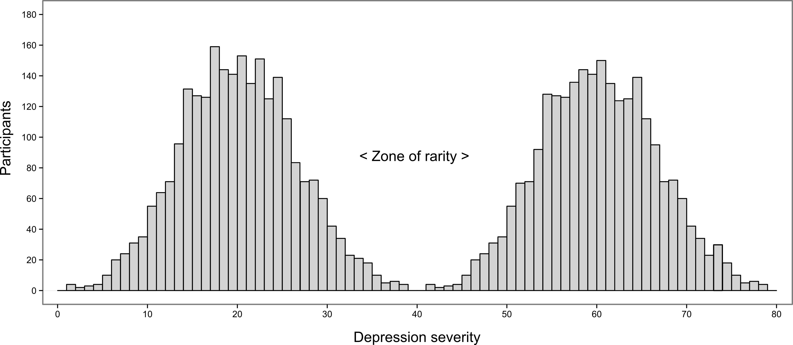
1. Dimensional vs. categorical view

Slide 25
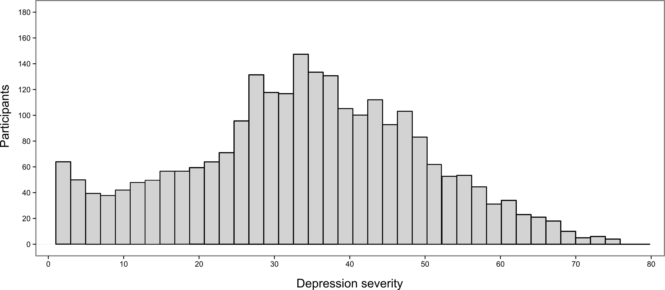
1. Dimensional vs. categorical view

Slide 26
1. Dimensional vs. categorical view
Overwhelming psychometric and taxometric evidence in favor of dimensional view
Many people have few problems, and then there are people with minor, moderate, severe, and very severe problems. There is no zone of rarity.
Idea of comparing depressed vs control group based on a threshold is problematic

Slide 27
1. Dimensional vs. categorical view
Subthreshold
The presence of subthreshold depression is often clinically significant, with depression-like levels of functional impairment, psychiatric and physical comorbidities, and increased risk of future depressive episodes

Slide 28
1. Dimensional vs. categorical view
Idea of comparing depressed vs control group based on a threshold is problematic

Slide 29
1. Dimensional vs. categorical view
While categorical definitions may be necessary for practical purposes, they have fostered reductionist thinking about depression.
  "What causes it"?
  "What are genetic predispositions for it"?

Slide 30
1. Dimensional vs. categorical view
"Essentialist Bias": belief that mental disorders are natural kinds is prevalent among both laypeople and medical professionals
(Pieter Adriaens & Andreas de Block)
Categorical belief in clinicians diminishes with experience
Categorical belief in clinicians associated with less empathy
Implicit essentialist worldview develops early in human cognition, applies to numerous domains of classification such as chemical elements, species, and emotions
Richard Dawkins: "The Tyranny of the Dichotomous Mind"
Notes:
At the turn of the 19th century, Koch discovered …

Slide 31
1. Dimensional vs. categorical view
Summary: studying 2 groups—"healthy" vs. "depressed"—ignores the dimensional nature of depression

Slide 32
2. Heterogeneity of MD
A natural kind has a clearly defined essence and a number of necessary and sufficient properties.
For medical and mental disorders, these properties are (among others) symptoms.
Notes:
So let's take a more detailed look at the symptoms.
The DSM lists 9 disparate psychiatric criterion symptoms for depression, which is quite a large number for one syndrome.

Slide 33
2. Heterogeneity of MD
DSM-5 diagnosis of depression
  Diminished interest or pleasure
  Depressed mood
  Increase or decrease in either weight or appetite
  Insomnia or hypersomnia
  Psychomotor agitation or retardation
  Fatigue or loss of energy
  Worthlessness or inapproriate guilt
  Problems concentrating or making decisions
  Thoughts of death or suicidal ideation
Notes:
So let's take a more detailed look at the symptoms.
The DSM lists 9 disparate psychiatric criterion symptoms for depression, which is quite a large number for one syndrome.

Slide 34
2. Heterogeneity of MD
DSM-5 diagnosis of depression
  Diminished interest or pleasure
  Depressed mood
  Increase or decrease in either weight or appetite
  Insomnia or hypersomnia
  Psychomotor agitation or retardation
  Fatigue or loss of energy
  Worthlessness or inapproriate guilt
  Problems concentrating or making decisions
  Thoughts of death or suicidal ideation
Notes:
On top of that, 8 of these symptoms are actually compound symptoms consisting of several subsymptoms.

Slide 35
2. Heterogeneity of MD
DSM-5 diagnosis of depression
  Diminished interest or pleasure
  Depressed mood
  Increase or decrease in either weight or appetite
  Insomnia or hypersomnia
  Psychomotor agitation or retardation
  Fatigue or loss of energy
  Worthlessness or inapproriate guilt
  Problems concentrating or making decisions
  Thoughts of death or suicidal ideation
>
>
>
Notes:
And three of the symptoms even have contrasting features
A very conservative estimation leads to 1497 unique symptom profiles that all qualify for the same diagnosis.

Slide 36
2. Heterogeneity of MD
DSM-5 diagnosis of depression
  Diminished interest or pleasure
  Depressed mood
  Increase or decrease in either weight or appetite
  Insomnia or hypersomnia
  Psychomotor agitation or retardation
  Fatigue or loss of energy
  Worthlessness or inapproriate guilt
  Problems concentrating or making decisions
  Thoughts of death or suicidal ideation
Diagnosis: 5 / 9 symptoms and at least 1 core symptom
2 depressed patients may not share a single symptom
>
>
Notes:
And three of the symptoms even have contrasting features
A very conservative estimation leads to 1497 unique symptom profiles that all qualify for the same diagnosis.

Slide 37
2. Heterogeneity of MD
HAMD: anxiety, genital symptoms, hypochondriasis, insights into the depressive illness
CESD: frequent crying, talking less, perceiving others as unfriendly
BDI: irritability, pessimism, punishment feelings
Huge sample of "depressed" individuals with massively different problems; potential explanation why we cannot find biomarkers or efficacious treatment
Contrasts with the idea of MD as natural kind

Slide 38
2. Heterogeneity of MD
Research study on a sample of 3,700 depressed patients
Goal: count unique symptom profiles
  (e.g., "sad mood, suicidal ideation, fatigue, insomnia, loss of interest")
Results:
  1,030 unique symptom profiles in 3,700 patients (3.6 patients per profile)
  83.9% of the profiles were endorsed by five or fewer individuals
  48.6% of the profiles were endorsed by only one individual
  The most common symptom profile exhibited a frequency of only 1.8%
Notes:
Considered highly representative
While cross-sectional, we have causality in here.

Slide 39

Isolation

Slide 40

Withdrawal

Slide 41

Dread

Slide 42

Confusion
(Nick Barclay)

Slide 43
3. Comorbidity
The high comorbidity rates of depression with other disorders such as generalized anxiety disorder and PTSD pose another problem for the notion of discrete diseases
Associations of genetic markers with particular mental disorders are small at best, and often not specific to one diagnosis
Dysregulations of glutamate neurotransmission implicated in the etiology of MD, schizophrenia, OCD, and anxiety disorders

Slide 44
Assumption 2:
MD as common cause for its symptoms
Notes:
Accepted in psych medicine just a few weeks ago

Slide 45
Common cause framework
Goes back to infectious diseases as well
Disorders itself are "invisible" (latent)—we cannot observe measles directly
M

Slide 46
Common cause framework
Goes back to infectious diseases as well
Disorders itself are "invisible" (latent)—we cannot observe measles directly
We can only observe the symptoms of measles
We can use symptoms to indicate the presence of measles
s1
M
s2
s3

Slide 47
Common cause framework
Goes back to infectious diseases as well
Disorders itself are "invisible" (latent)—we cannot observe measles directly
We can only observe the symptoms of measles
We can use symptoms to indicate the presence of measles
  This works because measles causes measles symptoms
s1
M
s2
s3

Slide 48
Common cause framework
The CC framework is responsible for symptom checklists in the rest of medicine and psychiatry
  We use symptom lists to determine the presence of an underlying disease
The CC framework explains why symptoms cluster: they have the same causal origin
  Fever, generalized rash, Koplik's spots → measles!
s1
M
s2
s3

Slide 49

Common cause framework
What does this mean for symptoms?
  Symptoms are equivalent & interchangeable indicators of underlying disease ("Assumption of symptom equivalence")
  Symptom number, not symptom nature is relevant
  Symptoms are "locally independent"; since they are derived from the same common cause, their correlations are spurious
72
W
74
73

Slide 50
Common cause framework
What does this mean for symptoms?
  Symptoms are equivalent & interchangeable indicators of underlying disease ("Assumption of symptom equivalence")
  Symptom number, not symptom nature is relevant
  Symptoms are "locally independent"; since they are derived from the same common cause, their correlations are spurious
72
W
74
73

Slide 51
Common cause framework
This "measurement detour" of latent variables is very common in psychology because the things we are often interested in cannot be observed directly
Mathematical intelligence
  Measured mathematical IQ via 3 questions
  Tests interchangeable
  Number of items solved is important
  Correlation among items spurious
q1
I
q2
q3

Slide 52
Common cause framework
Depression: use rating scale to measure depression symptoms
Most common scales:
  HAMD (1960)
  BDI (1961)
  CESD (1977)

Slide 53
Common cause framework
Depression: use rating scale to measure depression symptoms
Most common scales:
  HAMD (1960)
  BDI (1961)
  CESD (1977)
Add symptoms to sum-score. It doesn't matter what particular symptoms patients have (symptoms are interchangeable) as long as they have enough. The DSM-5, for instance, considers 5 (but not 4 or 6) symptoms enough to warrant a diagnosis.
  By now you understand why this is problematic.

Slide 54
Assumption 2: evidence?
Notes:
Accepted in psych medicine just a few weeks ago

Slide 55
1. Heterogeneity of symptoms
It is odd that one common cause triggers a huge variety of very different problems
  HAMD: anxiety, genital symptoms, hypochondriasis, insights into the depressive illness
  CESD: frequent crying, talking less, perceiving others as unfriendly
  BDI: irritability, pessimism, punishment feelings
It is odd as well that one common cause triggers symptomatic opposites (insomnia vs hypersomnia; appetite loss vs gain; psychomotor agitation vs regardation)

Slide 56
2. Symptoms differ from each other

Slide 57
2. Risk factors
There are many risk factors for "depression" (gender, age, neuroticism, life events, etc.)
s1
r1
s2
D
s3
r2
s4
s5

Slide 58
2. Risk factors
There are many risk factors for "depression" (gender, age, neuroticism, life events, etc.)
Individual MD symptoms have different risk factors
s1
r1
s2
s3
r2
s4
s5
(Fried et al., 2014)

Slide 59
2. Risk factors
There are many risk factors for "depression" (gender, age, neuroticism, life events, etc.)
Individual MD symptoms have different risk factors
(Fried et al., 2014)

Slide 60
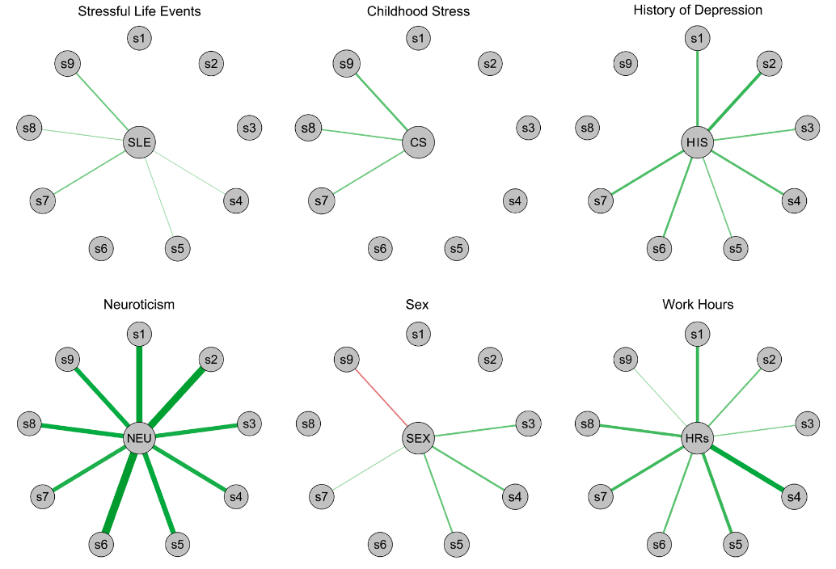
Notes:
Green lines are positive standardized regression weights of symptoms on risk factors, red lines negative ones. One of the most interesting effects here is sex: female sex (in this case the green lines) predicts increases of fatigue, sleep and appetite problems, while male interns are at a heightened risk to develop suicidal ideation during residency stress.
1 little interest or plea- sure in doing things (interest),
2 feeling depressed or hopeless (depressed),
3 sleep problems (sleep),
4 feeling tired (fatigue),
5 appetite problems (appetite),
6 feeling bad about yourself/that you are a failure (self-blame),
7 trouble concentrating on things (concentration),
8 mov- ing or speaking slowly/being fidgety or restless (psy- chomotor),
9 and suicidal ideation (suicide).

Slide 61
Notes:
Green lines are positive standardized regression weights of symptoms on risk factors, red lines negative ones. One of the most interesting effects here is sex: female sex (in this case the green lines) predicts increases of fatigue, sleep and appetite problems, while male interns are at a heightened risk to develop suicidal ideation during residency stress.
1 little interest or plea- sure in doing things (interest),
2 feeling depressed or hopeless (depressed),
3 sleep problems (sleep),
4 feeling tired (fatigue),
5 appetite problems (appetite),
6 feeling bad about yourself/that you are a failure (self-blame),
7 trouble concentrating on things (concentration),
8 mov- ing or speaking slowly/being fidgety or restless (psy- chomotor),
9 and suicidal ideation (suicide).

Slide 62
Notes:
Green lines are positive standardized regression weights of symptoms on risk factors, red lines negative ones. One of the most interesting effects here is sex: female sex (in this case the green lines) predicts increases of fatigue, sleep and appetite problems, while male interns are at a heightened risk to develop suicidal ideation during residency stress.
1 little interest or plea- sure in doing things (interest),
2 feeling depressed or hopeless (depressed),
3 sleep problems (sleep),
4 feeling tired (fatigue),
5 appetite problems (appetite),
6 feeling bad about yourself/that you are a failure (self-blame),
7 trouble concentrating on things (concentration),
8 mov- ing or speaking slowly/being fidgety or restless (psy- chomotor),
9 and suicidal ideation (suicide).

Slide 63
♂
Suicide ♂
Sleep ♀
Concentration ♀
Fatigue ♀
Eating ♀
Notes:
Green lines are positive standardized regression weights of symptoms on risk factors, red lines negative ones. One of the most interesting effects here is sex: female sex (in this case the green lines) predicts increases of fatigue, sleep and appetite problems, while male interns are at a heightened risk to develop suicidal ideation during residency stress.
1 little interest or plea- sure in doing things (interest),
2 feeling depressed or hopeless (depressed),
3 sleep problems (sleep),
4 feeling tired (fatigue),
5 appetite problems (appetite),
6 feeling bad about yourself/that you are a failure (self-blame),
7 trouble concentrating on things (concentration),
8 mov- ing or speaking slowly/being fidgety or restless (psy- chomotor),
9 and suicidal ideation (suicide).

Slide 64

2. Impairment
MD can cause severe levels of impairment of psychosocial functioning (work life, friends, private relationships, etc.)
Individual MD symptoms have differential impact on impairment
(Fried et al., 2014)

Slide 65
Notes:
((CI obtained through bootstrapping capabilities of rela impo package
Predicted RI by means, not significant.))

Slide 66
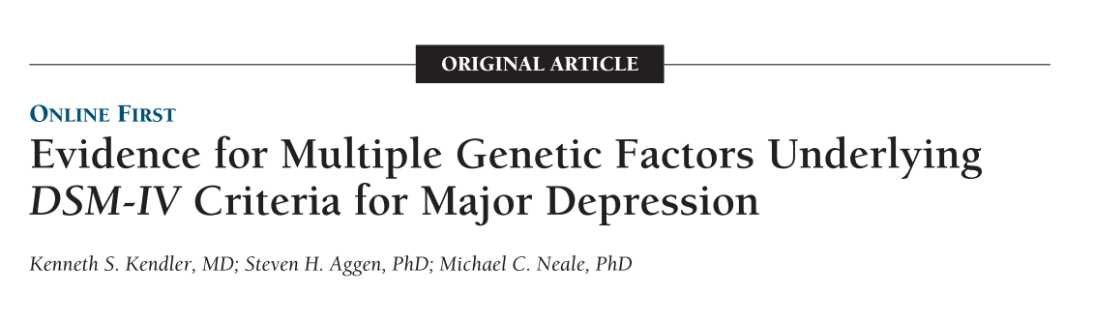
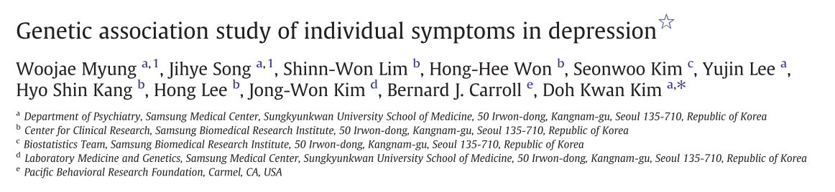
2. Underlying biology
Individual MD symptoms differ in their underlying biology

Slide 67
2. Underlying biology
Individual MD symptoms differ in their underlying biology
  Depression symptoms differ from each other in their degree of heritability (somatic symptoms such as loss of appetite and loss of libido, & cognitions such as guilt or hopelessness showed highest heritabilities)
  Differential associations of symptoms with specific genetic polymorphisms; 'middle insomnia' correlated with the GGCCGGGC haplotype in the first haplotype block of TPH1.
  Analysis of post-mortem brains; 80% of the variation in suicidal behavior explained by how polymorphisms of the gene SKA2 interacted with anxiety and stress.

Slide 68
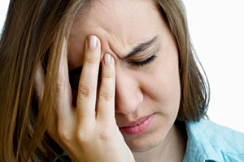
3. Symptoms and life events
Life events are among the most robust triggers of MD
Serious stressors increase risk for developing MD by 350-800%
Evidence that specific life events may trigger specific MD symptom profiles (Matthew C. Keller)
  Romantic breakups > sadness, anhedonia, appetite loss, guilt
  Chronis stress > fatigue, hypersomnia
  Bereavement > loneliness, sadness

Slide 69
3. Symptoms and life events
Life events are among the most robust triggers of MD
Serious stressors increase risk for developing MD by 350-800%
Evidence that specific life events may trigger specific MD symptom profiles (Matthew C. Keller)
  Romantic breakups > sadness, anhedonia, appetite loss, guilt
  Chronis stress > fatigue, hypersomnia
  Bereavement > loneliness, sadness

Slide 70
4. Antidepressant side-effects
Significant side effects documented in about 27% of all clinical trials
Common side effects include insomnia, hypersomnia, nervousness, anxiety, agitation, tremor, restlessness, fatigue, somnolence, weight gain or weight loss, increased or decreased appetite, hypertension, sexual dysfunction, dry mouth, constipation, blurred vision, and sweating
We track the effect of antidepressants on sum-scores of symptoms over time to determine their efficacy although specific symptoms are exacerbated by antidepressants

Slide 71
5. Symptoms influence each other
Evidence for direct influences of symptoms on each other
  Insomnia > fatigue > concentration problems
Violation of local independence
Many MD patients are caught in vicious circles of problems that fuel and maintain each other, a notion well-established in the psychotherapy literature
s1
D
s2
s3

Slide 72
Symptoms as distinct entities connected in networks of direct influences
Notes:
Accepted in psych medicine just a few weeks ago

Slide 73
Network perspective
Assumption 1: MD as natural kind
  Evidence: MD is a fuzzy and highly heterogeneous syndrome that substantially overlaps with other diagnoses such as anxiety disorders
  Dramatic lack of progress in research that understands MD as consistent, discrete disease category (e.g., antidepressant efficacy, biomarkers)
Assumption 2: MD as common cause for its symptoms
  Evidence: MD is not the common cause for the symptoms. Symptoms differ in important properties and cause each other over time.

Slide 74
Network perspective
Traditional: symptoms cluster because of a shared origin
Network view: symptoms cluster because they influence each other.

Slide 75
Network perspective
Symptoms have autonomous causal power and are not mere passive consequences of a common cause

Slide 76
Network perspective
Symptoms are separate entities that can differ in important aspects

Slide 77
Network perspective
Symptoms are not interchangeable indicators of an underlying disorder. Sum-score are highly problematic because we are adding apples and oranges
  What do 14 points on the BDI exactly mean?
  What does the BDI exactly measure?

Slide 78
Network perspective
Research on network approaches to depression started in 2010, and a number of papers have shown that this framework offers novel insights in different domains
  Comorbidity
  Centrality
  Experience Sampling
  Heritability

Slide 79
1. Comorbidity research
Depression is a highly comorbid condition
Traditionally, a patient is understood to have 2 separate diseases; explained by general susceptibility towards negative affect, or by shared genes that predispose for both disorders
But MD and other diagnoses overlap substantially in their symptoms:
  MD & GAD: 'sleep problems', 'fatigue', 'concentration problems', and 'psychomotor agitation'
  MD & PTSD: 'loss of interest', 'concentration problems', 'sleep problems', 'low mood', and 'self-blame'

Slide 80
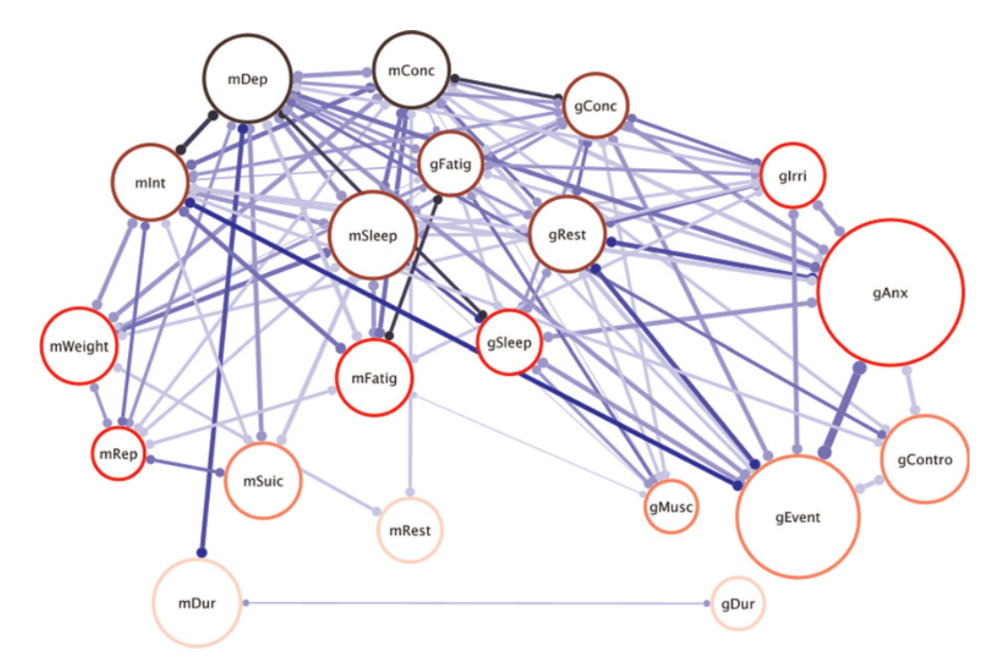
1. Comorbidity research
(Cramer et al., 2010)

Slide 81
1. Comorbidity research
MD and GAD overlap substantially and do not have clear boundaries
Bridge symptoms such as 'insomnia' transfer the activation of one part of the network to the other part
Remember from before:
  "Associations of genetic markers with particular mental disorders are small at best, and often not specific to one diagnosis"
This is exactly what we would expect considering that
  different symptoms may have different underlying genetics
  different diagnoses overlap in their symptoms

Slide 82
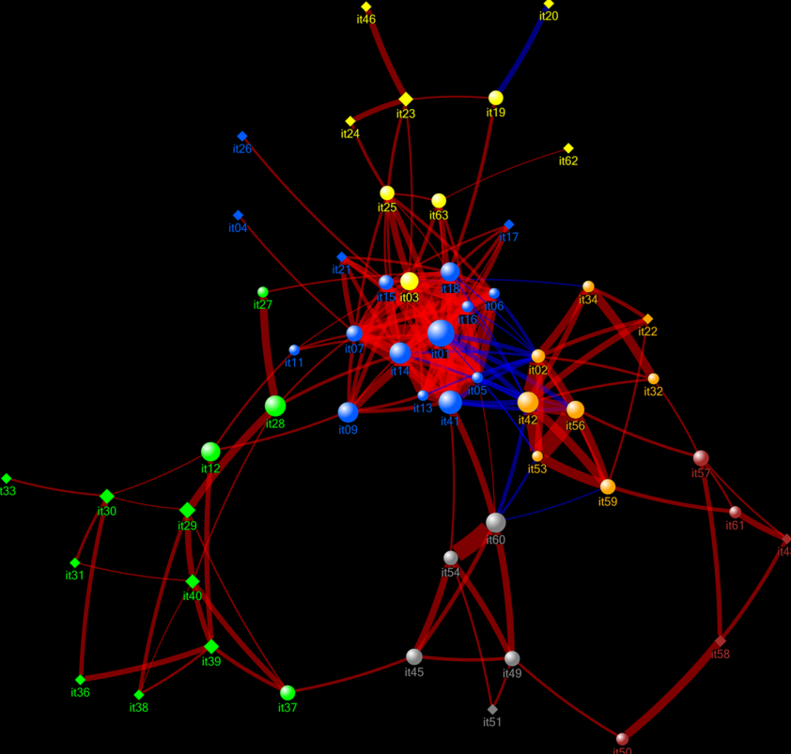
1. Comorbidity research
(Goekoop & Goekoop, 2014)

Slide 83
2. Centrality
New perspective on clinical relevance: centrality
A central symptom is one that exhibits a large number of connections in a network; switching on this symptom will likely spread symptom activation throughout the network
A peripheral symptoms is on the corner of a network and has few connections

Slide 84
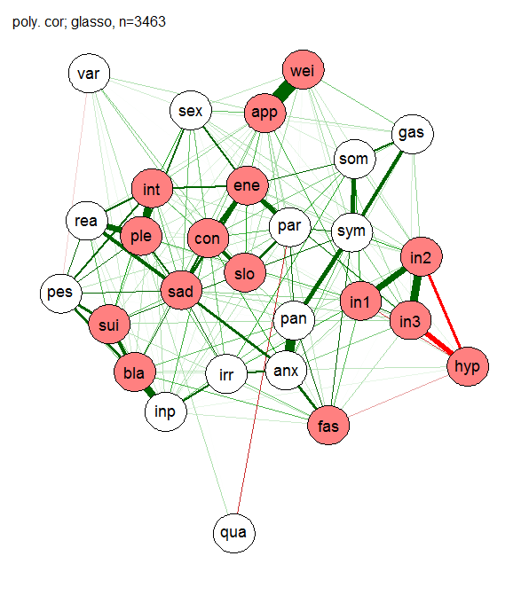
2. Centrality

Slide 85
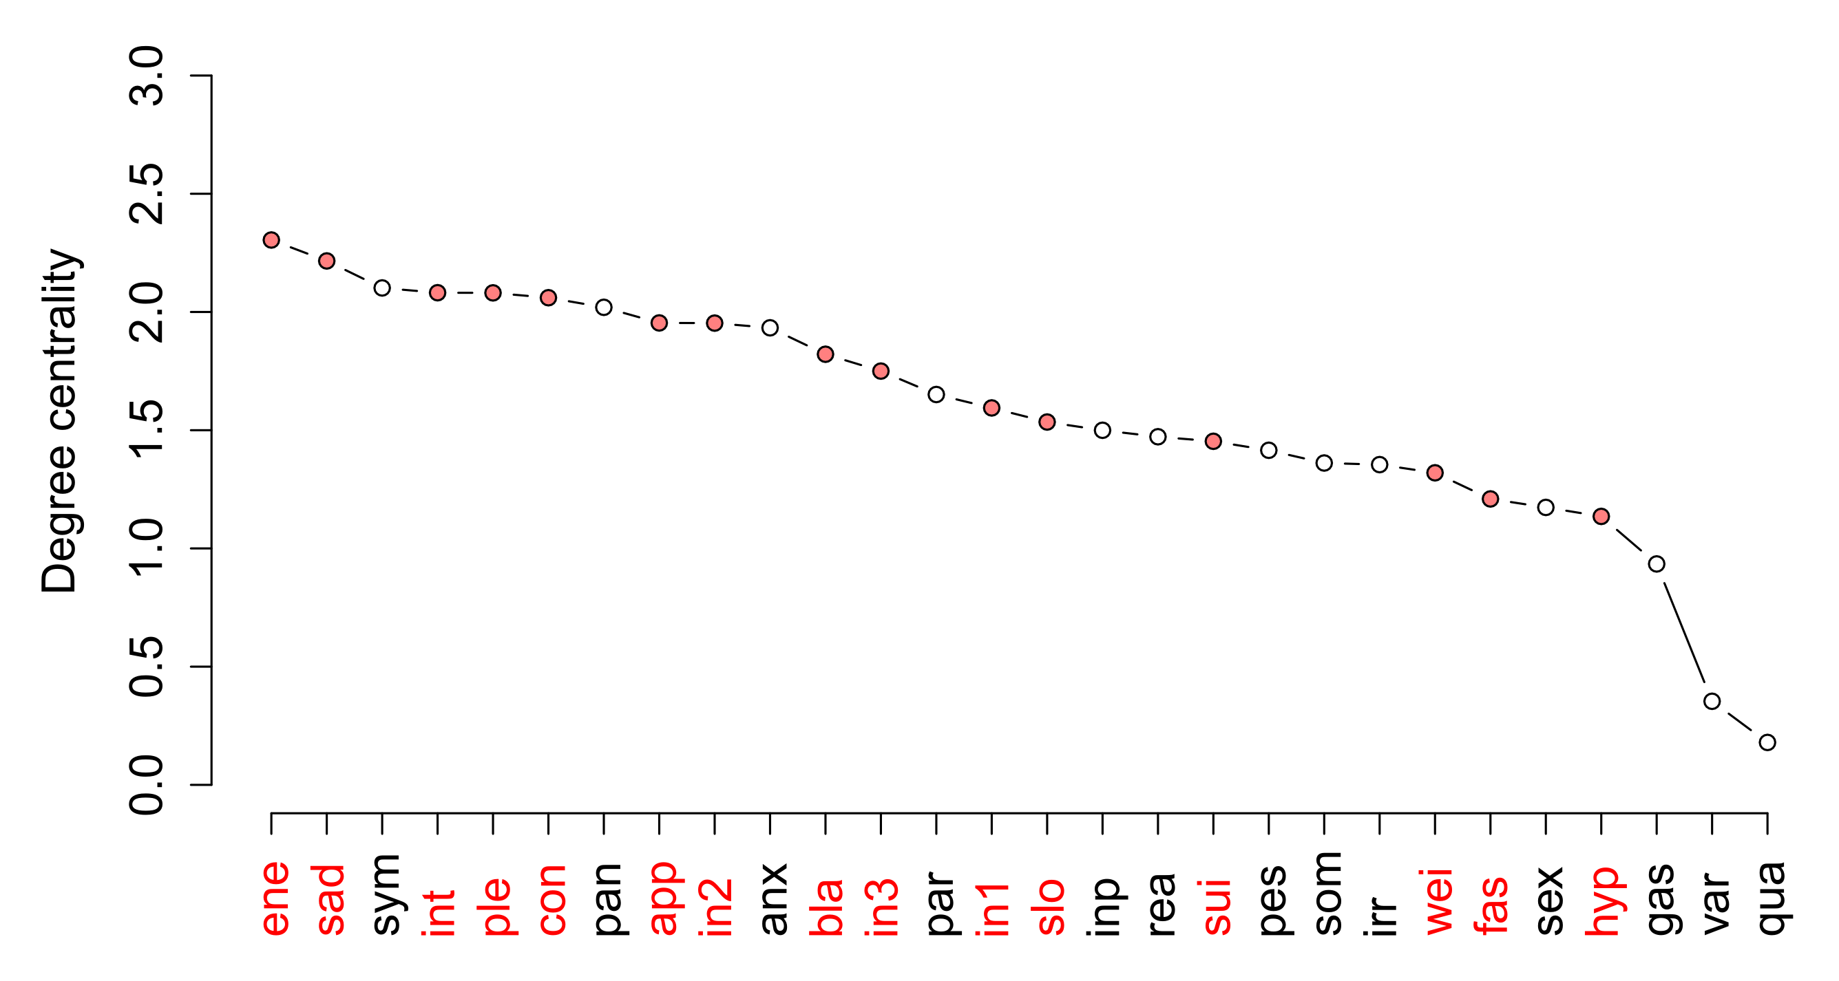
2. Centrality

Slide 86
2. Centrality
Centrality important for intervention and prevention
Intervention

Slide 87
2. Centrality
Study: causally central depression symptoms (symptoms that trigger many other symptoms across time) … (Kim & Ahn)
  are judged to be more typical symptoms of depression,
  are recalled with greater accuracy than peripheral symptoms,
  are more likely to result in an MDD diagnosis
Causal thinking of clinicians contrasts with the atheoretical DSM approach of symptom sum-scores

Slide 88
3. Experience sampling
Multiple measures per day for several weeks, often based on smartphone apps (Laura Bringmann)
Allows for constructing a directional symptom network
Makes both nomothetic and idiographic analyses possible

Slide 89
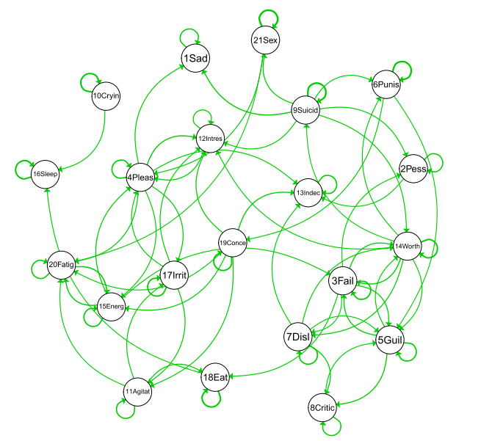
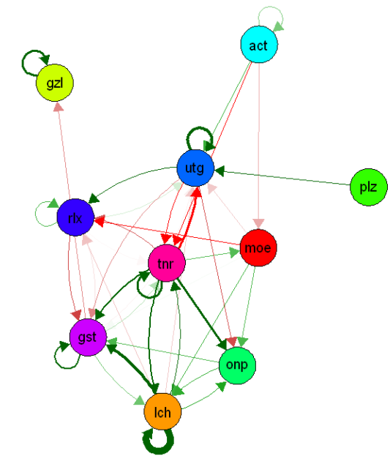
3. Experience sampling
Nomothetic
Idiographic
(Bringmann et al., 2014)
(Kroeze, 2014)

Slide 90
4. Heritability
Genetic liability in edges instead of nodes?

Slide 91
Implications for future MD research
Notes:
Accepted in psych medicine just a few weeks ago

Slide 92
Implications
Utilize a symptom-based approach that promises important clinical insights
  Antidepressants
  Genetics
  Brain correlates
  Psychological research (e.g., risk factors)
Notes:
This leads to four implications
+treatment efficacy, genetics, neuroimaging are fields that may potentially benefit from these analyses
2. if psychomotor retardation and agitation have different risk factors, and a different underlying genetic architecture, and contribute differentially to functioning, we need to investigate them separately

Slide 93

Implications
Symptom assessment: quality
Notes:
This leads to four implications
+treatment efficacy, genetics, neuroimaging are fields that may potentially benefit from these analyses
2. if psychomotor retardation and agitation have different risk factors, and a different underlying genetic architecture, and contribute differentially to functioning, we need to investigate them separately

Slide 94
Implications
Symptom assessment: quality
  Insomnia vs hypersomnia
  Psychomotor retardation vs agitation
  Appetite gain vs appetite loss
Notes:
This leads to four implications
+treatment efficacy, genetics, neuroimaging are fields that may potentially benefit from these analyses
2. if psychomotor retardation and agitation have different risk factors, and a different underlying genetic architecture, and contribute differentially to functioning, we need to investigate them separately

Slide 95
Implications
Symptom assessment: quantity
  Anxiety: highly prevalent marker of more severe, chronic, and complex MDD
Notes:
This leads to four implications
+treatment efficacy, genetics, neuroimaging are fields that may potentially benefit from these analyses
2. if psychomotor retardation and agitation have different risk factors, and a different underlying genetic architecture, and contribute differentially to functioning, we need to investigate them separately

Slide 96
Implications
Symptom assessment: quantity
  Anxiety: highly prevalent marker of more severe, chronic, and complex MDD
  Nightmares increase suicide risk
Notes:
This leads to four implications
+treatment efficacy, genetics, neuroimaging are fields that may potentially benefit from these analyses
2. if psychomotor retardation and agitation have different risk factors, and a different underlying genetic architecture, and contribute differentially to functioning, we need to investigate them separately

Slide 97
Implications
Use multiple rating scales if sum-scores are necessary
  Sum scores of common rating scales are only moderately correlated
  (~ 0.4).
  Scales differ in how they classify depressed patients into severity groups; particular scale chosen can bias who qualifies for enrollment, and who achieves remission
  If sum-scores have to be used, use multiple different rating scales and check for robustness of effects.
Notes:
This leads to four implications
+treatment efficacy, genetics, neuroimaging are fields that may potentially benefit from these analyses
2. if psychomotor retardation and agitation have different risk factors, and a different underlying genetic architecture, and contribute differentially to functioning, we need to investigate them separately

Slide 98
Implications
Report symptom profiles
  Differences in results across studies may be due to differential symptom profiles of study samples
Notes:
This leads to four implications
+treatment efficacy, genetics, neuroimaging are fields that may potentially benefit from these analyses
2. if psychomotor retardation and agitation have different risk factors, and a different underlying genetic architecture, and contribute differentially to functioning, we need to investigate them separately

Slide 99
Implications
Transdiagnostic symptom assessment
  Insomnia causes fatigue irrespective of a person's diagnosis. High comorbidity rates, most people have a lot of very diverse symptoms
  Use a transdiagnostic symptom battery
  Do not use skip questions!
Notes:
This leads to four implications
+treatment efficacy, genetics, neuroimaging are fields that may potentially benefit from these analyses
2. if psychomotor retardation and agitation have different risk factors, and a different underlying genetic architecture, and contribute differentially to functioning, we need to investigate them separately

Slide 100
Implications
Symptoms as active variables that hold autonomous causal power; investigate causal associations across time
Notes:
I suggest modeling causal associations between symptoms across time.
If symptoms are not just passive indicators, we shuold treat them as active variables that hold autonomous causal power
The important question becomes: what symptoms are especially causally central in psychopathological networks? This will provide important insights for example for treatment so we can target symptoms that spread symptom activation through the network.

Slide 101








Thank you

